Slide 1
Search for Screenings/ Initiate New Screenings

Slide 3
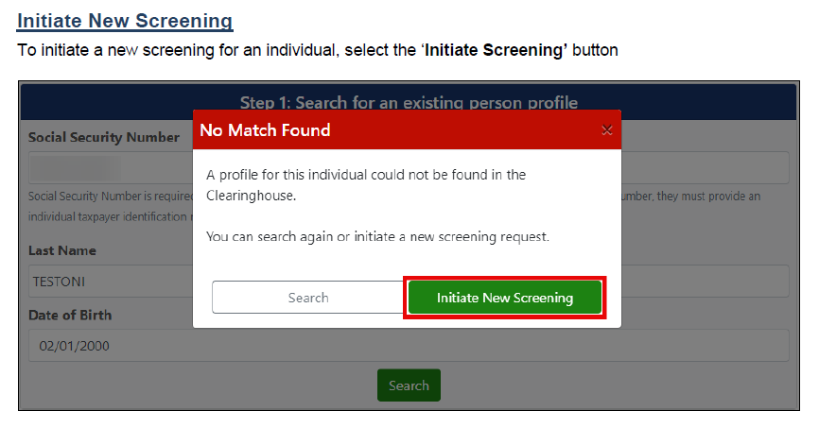

Slide 6
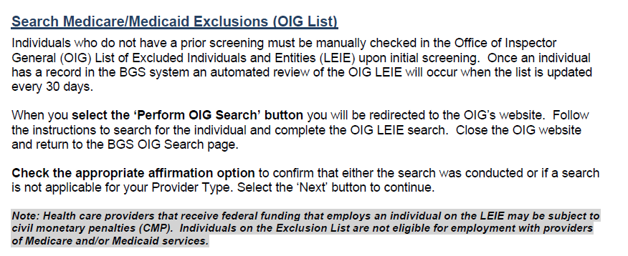

Slide 10
